Slide 1

Split & Share
Team Charmander Presents:

Slide 2
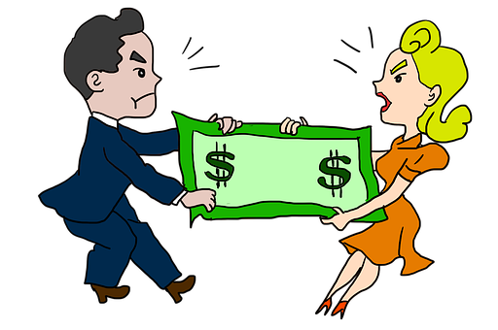
About Our Project
As a group we made the decision to design an app prototype called Split and Share.
Split and Share is a money pooling and money transferring app.
The idea to design this prototype was motivated by the frustrations of paying at a restaurant when sharing the bill with a group of friends.
Chasing after friends for money is not fun, Split and Share is looking to eliminate that problem!
We got inspiration from already existing methods like cashapp & E-transfer.

Slide 3
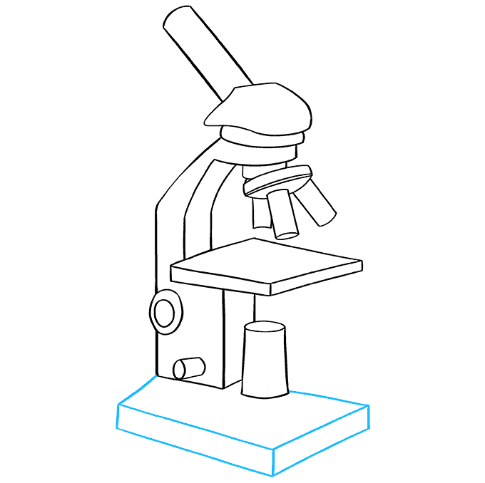
Research
As a group we used a number of research methods to gather information to improve our iterative design. The methods we used were:
Questionnaires
Interviews
Surveys

Slide 4
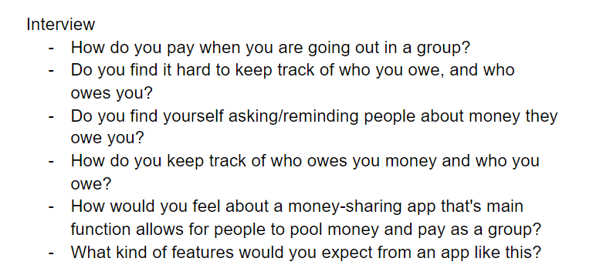

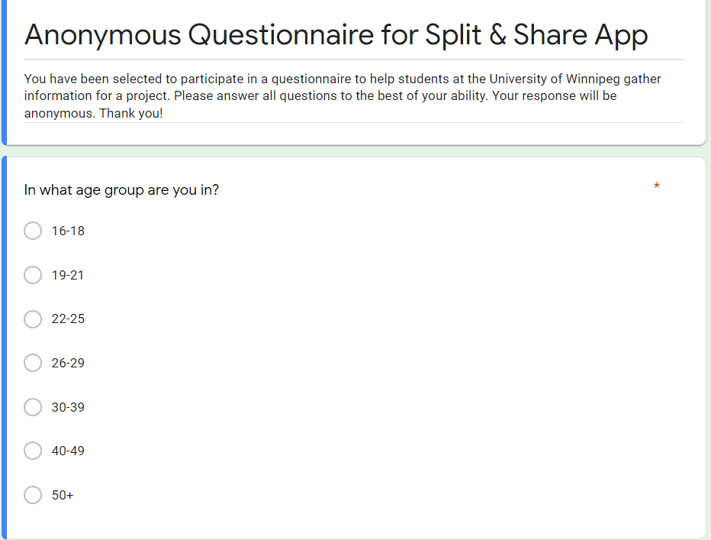
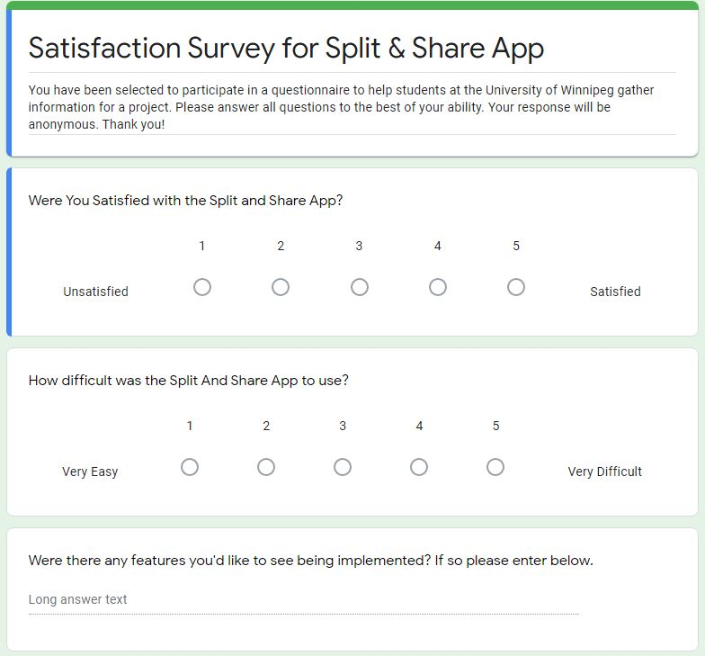
Research Methods
Interview Questions
Questionnaire
Survey

Slide 5
Milestone 1
Thought about the problems we were looking to solve, and agreed that an app would be the best design direction.
Create a money pooling/sharing app for Canadians
Make it more efficient than E-transfer
Keep track of who owes the user
We realized there would be personal and business applications of the app, and had to take into account both of these when Brainstorming.
Brainstormed features we would need, used data from questionnaires/interviews to help with this.

Slide 6
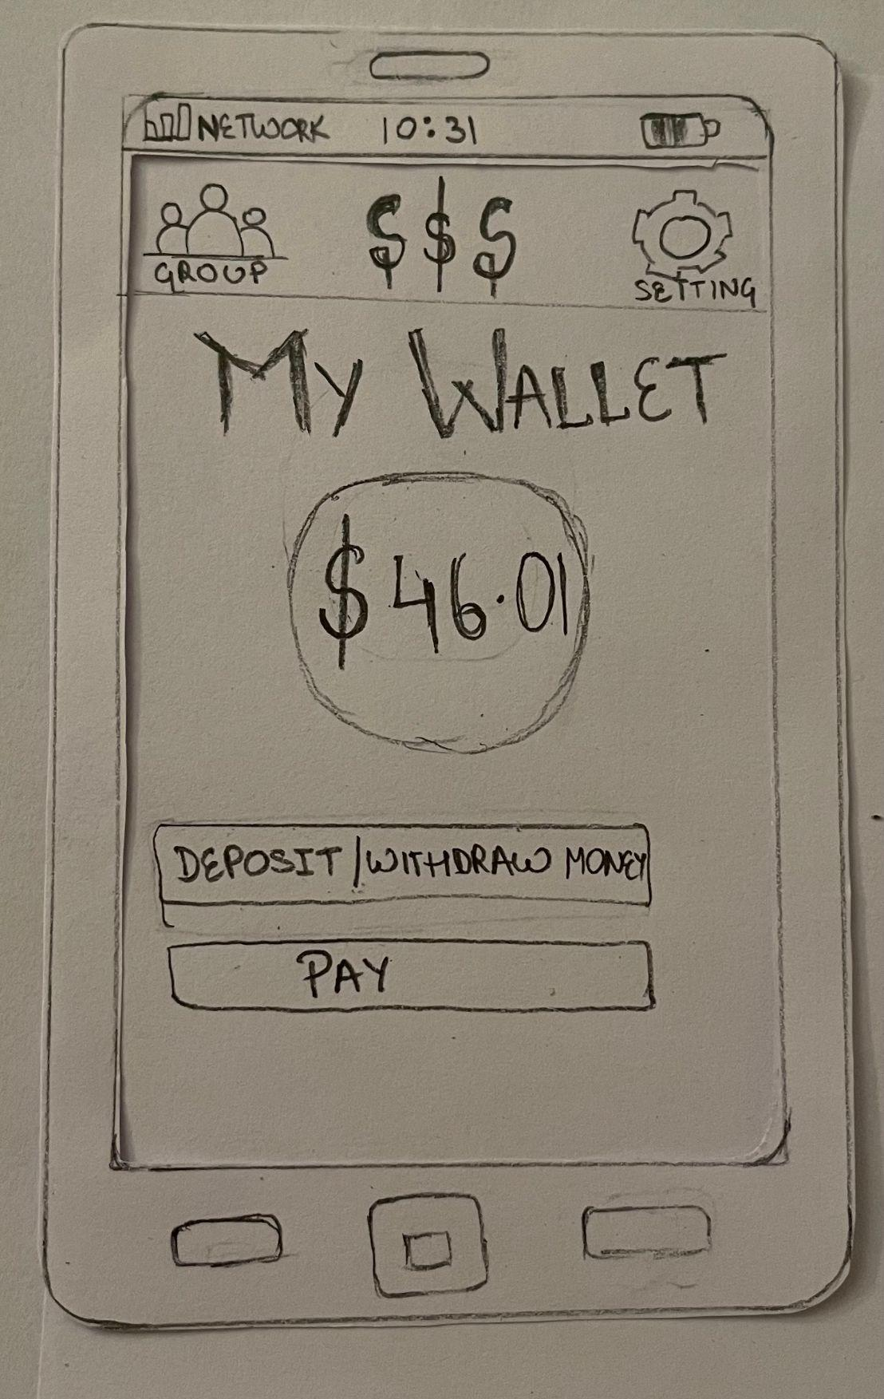
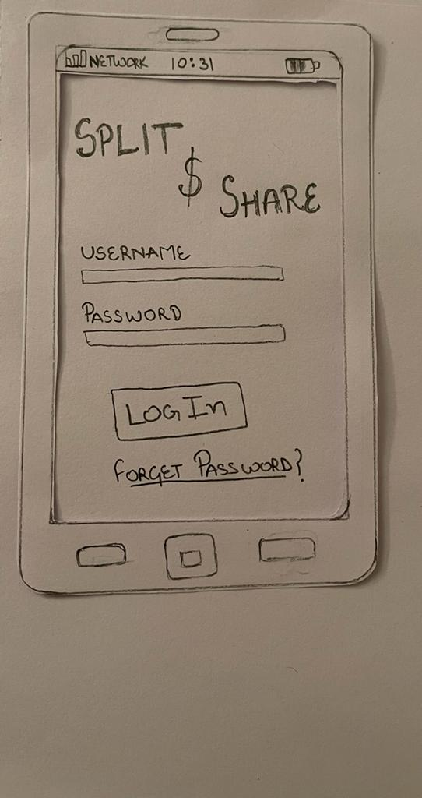
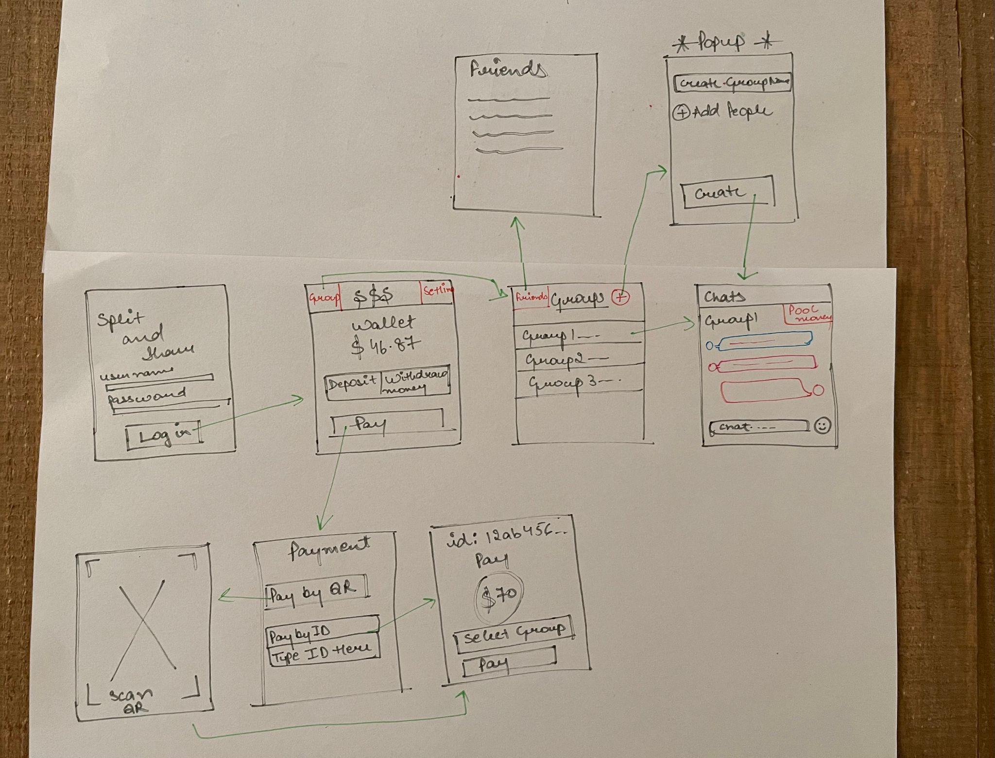
Milestone 2
Developed an initial design by doing rough sketches, and then made a polished paper prototype by implementing ideas we liked from each group members sketches.
Performed user evaluations on the paper prototype.

Slide 7

Milestone 2
We discovered:
Some buttons did not lead to screens
Some buttons were unclear
Users were confused about the reasoning for a QR code scanner
We considered this data when designing our initial digital prototype.
Each of us performed a cognitive walkthrough, which helped us pick out problems that were present in the digital prototype.

Slide 8
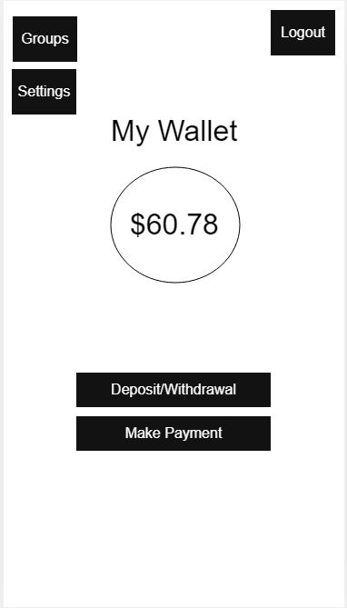
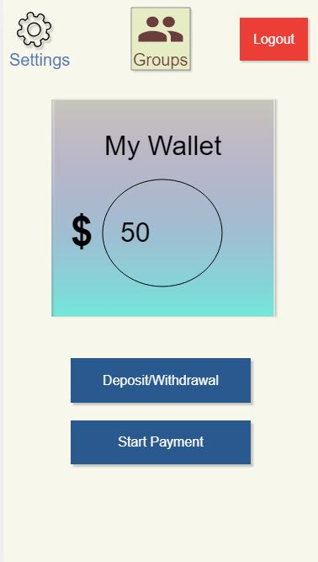

Final Milestone
In our final milestone we reviewed the results from our Cognitive Walkthrough and vertically implemented the changes into our digital prototype.
Old
Digital Prototype
Revised Vertical Prototype

Slide 9
Final Milestone
We implemented functionality of most features so we could perform usability tests on potential users.
Each of the group members then did a usability test asking commonly used tasks for a participant to do.
The result of the usability test revealed problems in our prototype that we didn’t pick up in our previous tests, like user evaluation and cognitive walkthroughs. These would be dealt with in future recommendations.

Slide 10

Future Recommendations
Future Recommendations Consist of:
Improving visuals.
Complete the vertical prototype by adding all functionality.
Adding transaction security, currency exchange methods.
Testing with local businesses.

